Slide 1
Name: Md. Sohan Millat Sakib ID:222902036
Simple Encryption

Slide 2
CONTENTS:
Introduction .
Objectives .
Tools & Languages used in the Project .
Features used in this project.
Implementations Limitations & Future Updates .
Conclusion .

Slide 3
Introduction
Encryption is the method by which information is converted into secret code that hides the information's true meaning.
Decryption converts an encrypted or encoded message into a readable form and can be understood by the user or system.

Slide 4
Objectives
Encrypt or Decrypt any message for security purpose.
Hide data from hackers and unwanted people.
Using for secret communication.

Slide 5
Tools & Languages used in the Project
Using Code Blocks for writing code.
Using C(C11) language for developing the program.
I use GCC Compiler for compiling the Code.
This Program runs on terminal.

Slide 6
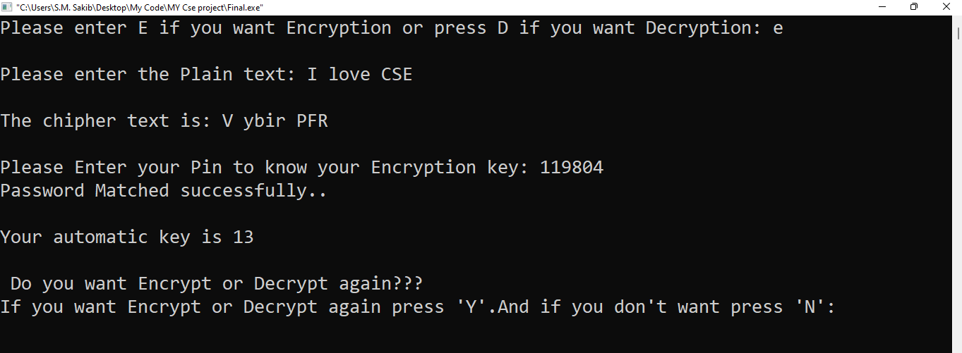
Implementation
Caesar cipher: Caesar cipher is a simple Encryption method that encrypts plain text into cipher text by a key. And if we want to decrypt message we have to know about the key.
Here the program Encrypted message by using key using 13 which is automatic generated.

Slide 7
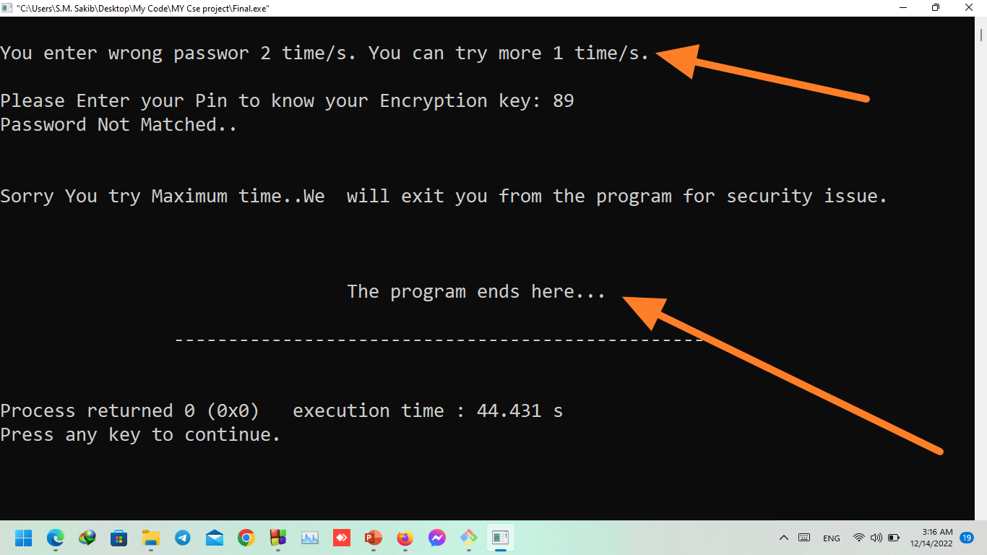
If I enter the wrong pin to get the key it will not give me the key to decrypt the message and if put wrong password 3 times program will be closed.

Slide 8
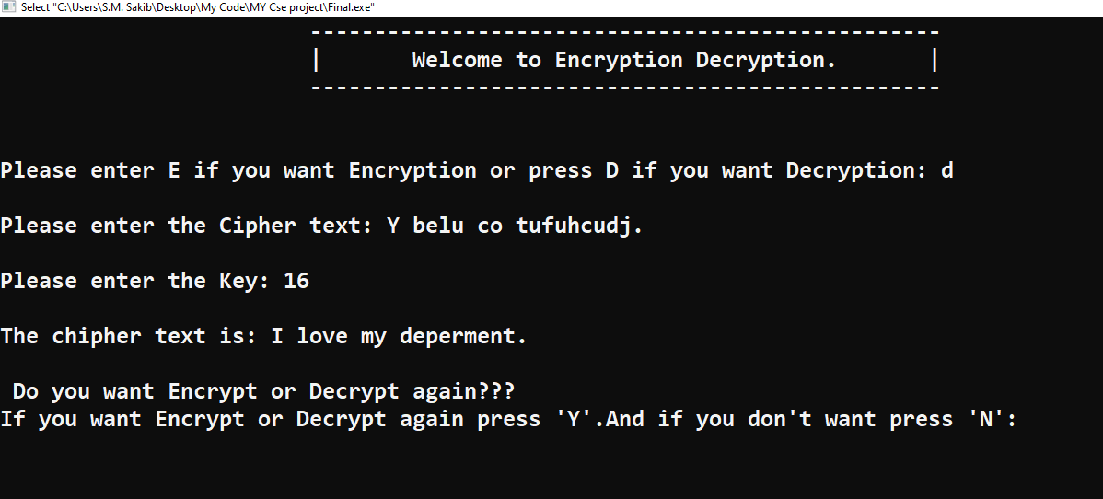
If I know key and I have encrypted message I can easily decrypt the message.

Slide 9
Features used in this project

